Slide 1
ONLINE VOTING SYSTEM
SHEETAL GUPTA
2200290140142
PROJECT SUPERVISIOR:DR.SHASHANK BHARDWAJ

Slide 2
INDEX
Introduction
Technologies
Hardware Requirement
Modules Description
Report
Conclusion
Gantt Chart

Slide 3

INTRODUCTION
An online voting system is a software platform that allows groups to securely conduct votes and elections. High-quality online voting systems balance ballot security, accessibility, and the overall requirements of an organization's voting event.
in the digital age, technology has significantly transformed many aspects of our lives, including the way we conduct elections. Traditional paper-based voting systems have been gradually giving way to more efficient, accessible, and secure online voting systems.

Slide 4
TECHNOLOGIES
HTML
CSS
JAVASCRIPT
PHP
MY SQL

Slide 5
HARDWARE REQUIREMENTS/SOFTWARE REQUIREMENTS
HARDWARE REQUIREMENTS
Hardware: Processor i3 or above
Clock speed: 3.0 GHz
RAM size: 4 GB or above
Hard Disk capacity: 500 GB or above
SOFTWARE REQUIREMENTS
Operating System: Windows 10
Browser: Google chrome or any other
Application software: Visual Studio Code
Technology: PHP
Server Required: XAMPP
Language Required: HTML, CSS, JAVASCRIPT
Documentation: MS Word

Slide 6
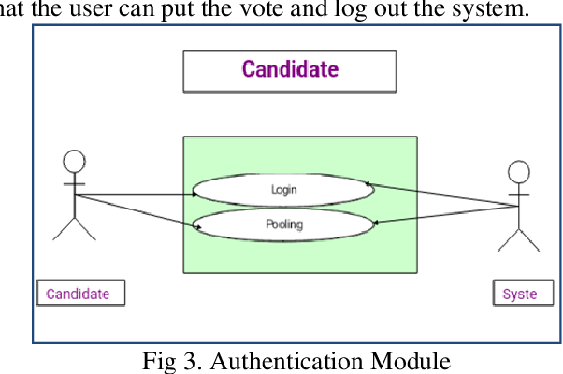
MODULE DESCRIPTION
Authentication Module:
Responsible for verifying the identity of voters.
Implements various authentication methods such as username/password, biometric verification, or multi-factor authentication.
Voter Registration Module:
Allows eligible voters to register for the online voting system.
Collects necessary information such as name, address, and other identifying details.
Ballot Creation Module:
Facilitates the creation of digital ballots for different elections.
Voting Module:
Provides the interface for voters to cast their votes online.
Presents the digital ballot to the voter in a user-friendly manner.
Vote Submission Module:
Receives and processes votes submitted by voters.
Validates votes to ensure they meet the requirements and are properly formatted..

Slide 7
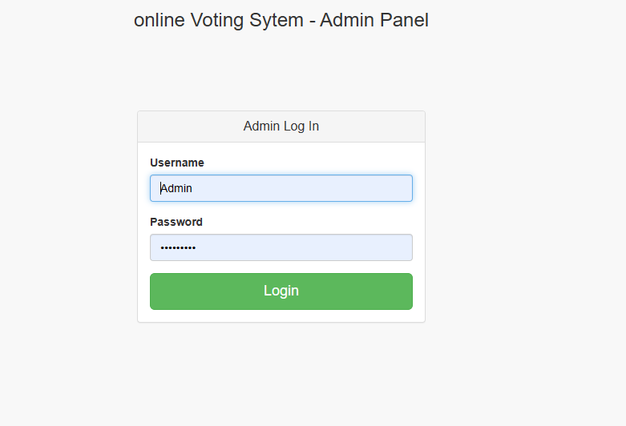
Admin

Slide 8
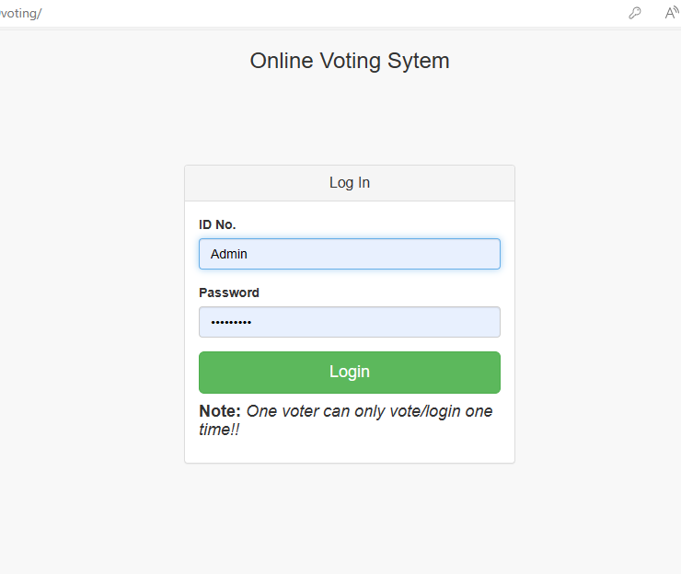
Sign Up

Slide 9
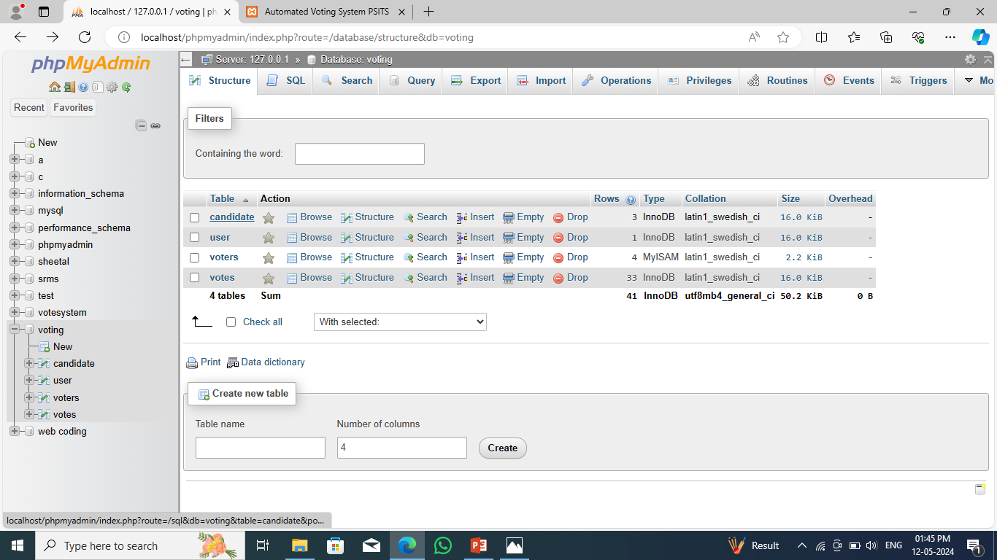
Database

Slide 10
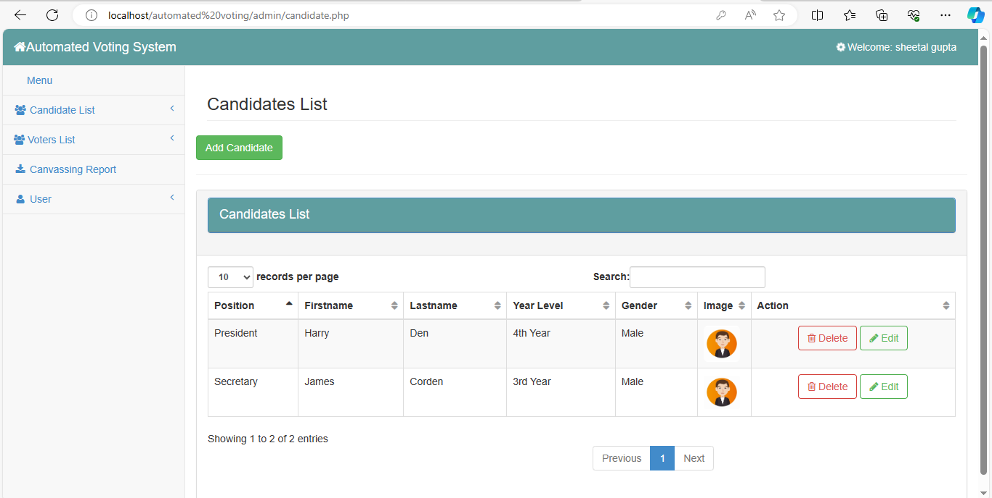
Main View

Slide 11
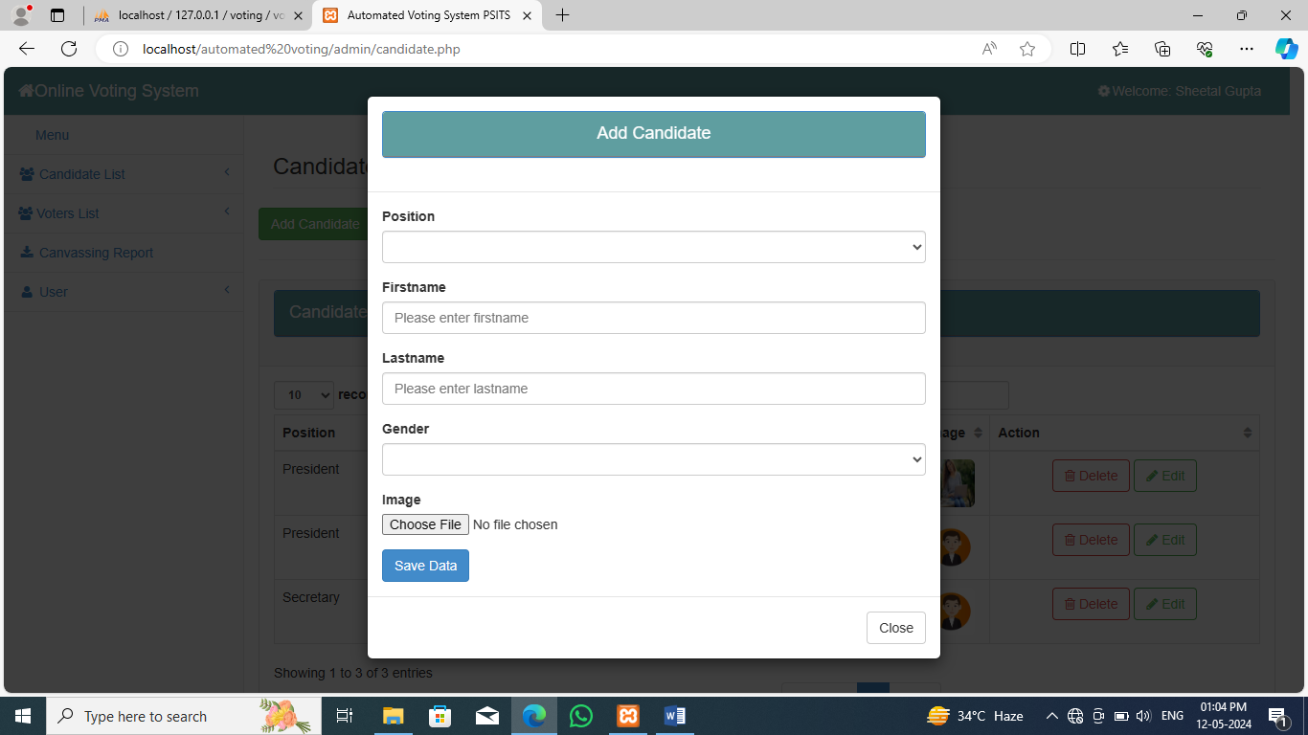
Add Candidate

Slide 12
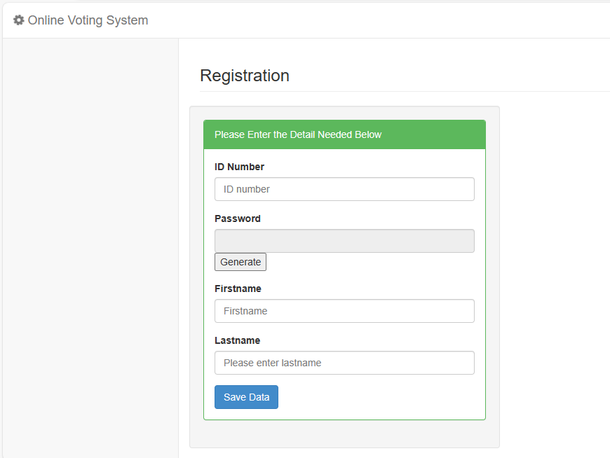
Add Voter

Slide 13
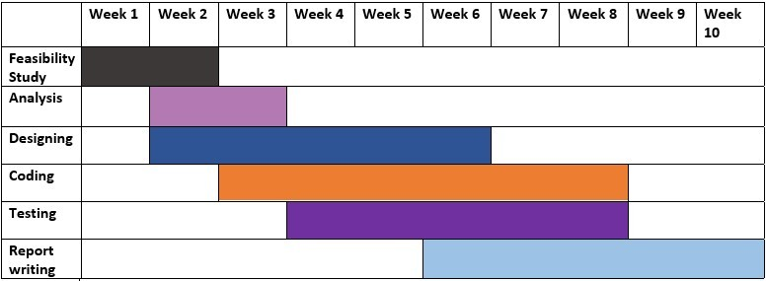
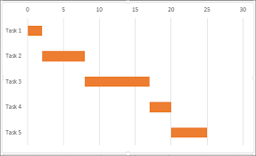
GANTT CHART

Slide 14
CONCLUSION
this Online Voting system will manage the Voter’s information by which voter can login and use his voting rights .
The system will incorporate all features of Voting system .
Generally voting has to be perform by user by going to the voting center .Many uses like army person or NRI cannot come to the voting place.
Therefore we have to implement online voting system by which the user can vote over the online. It is one of the greatest advantage for NRI and person who go outside the country they can vote on online by our software

Slide 15
Thank You

